Slide 1
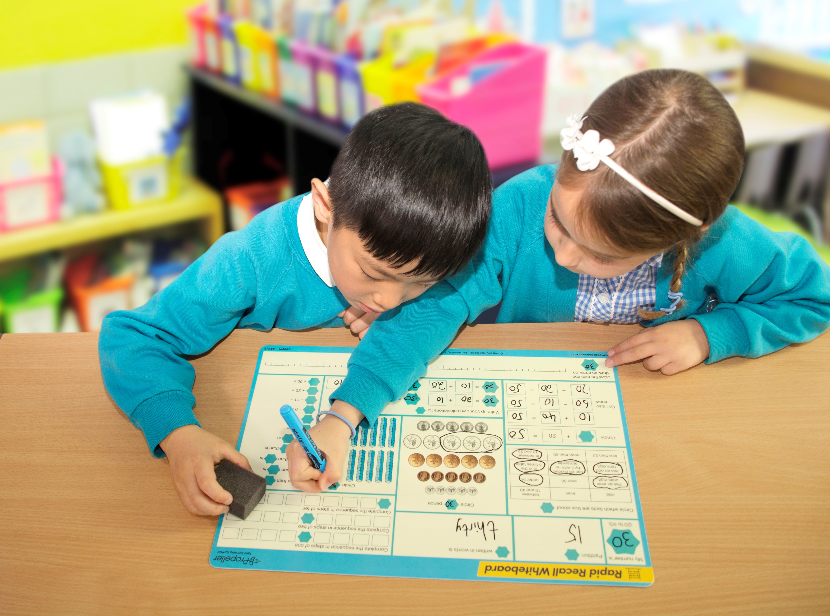

Getting to know your Rapid Recall Whiteboard
Notes:
Try to have a range of boards on offer to staff to explore throughout the session. You can ask staff to begin by trying to lay the boards in order from Year 1 to Year 6.

Slide 2


What are Rapid Recall Boards?
Notes:
Introduction –
What are the Rapid Recall Boards?
Play embedded video to introduce staff to the boards
What are Rapid Recall Boards?
They are a brilliant visual assessment tool to inform teaching – you can quickly differentiate the board by your choice of number
They cover many of the National Curriculum ‘Number’ objectives for any year between 1 and 6 (see https://www.propeller.education/objectives-covered-by-rapid-recall-whiteboards/
In the Summer of 2017, we updated the boards to include intelligent practice and variation, as well as add a new anti-glare, cream tint to support pupils with visual impairments

Slide 3
Getting to know your boards…
In pairs, spend 5 minutes exploring your boards and complete the following:
Locate the side and the year group of your board
Discuss the objectives that could be met from using the board
What skills could the board develop?
What mathematical vocabulary would the children need to understand
to fully access the board?
How could you differentiate the board?
Then…
Put the boards in order from Year 1 to Year 6 and look at progression
Notes:
Get the teachers in the room to spend 5 minutes exploring both sides of the board in pairs. Have one board from each year group on the table.
Ask them to spend 5 minutes trying to work out
Where the Year group and side are stated
What concepts are covered
How they could differentiate the board with their class
Are there any activities in particular they could expand on and turn into whole lessons
Then challenge each table to put the boards in order from Year 1 to Year 6 to look at progression

Slide 4
Suggestion 1 – The Timed Snapshot
Notes:
Ask the adults as they complete the activity individually and in silence.
- How might this make the child feel?
- Did you work through the board in a particular order?
- Did you avoid certain parts? If so, as a teacher, what could you ascertain if you see blank sections of a child’s board?
- Did you choose their first section based on feeling really confident in that area?
- Would this approach be suitable for all children?
- How could you modify this approach for less confident children (working in pairs, on circled parts of the board only…)
- Do you think that if you regularly practised in this way your time and fluency skills would improve?

Slide 5
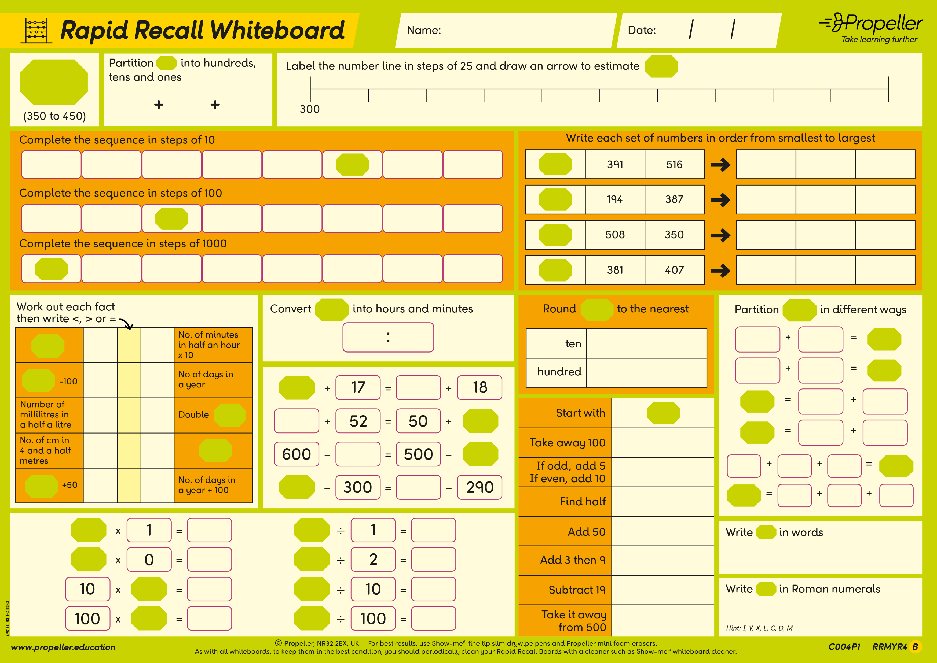

Challenge! Now it is you turn to try the timed snapshot
Your number is 379
How much of the
Year 4 Board - Side B can you complete in five minutes?
379
Click here for Answers
Notes:
Ask the adults as they complete the activity individually and in silence.
- How might this make the child feel?
- Did you work through the board in a particular order?
- Did you avoid certain parts? If so, as a teacher, what could you ascertain if you see blank sections of a child’s board?
- Did you choose their first section based on feeling really confident in that area?
- Would this approach be suitable for all children?
- How could you modify this approach for less confident children (working in pairs, on circled parts of the board only…)
- Do you think that if you regularly practised in this way your time and fluency skills would improve?
Then, Show teachers the online marking portal at https://www.propeller.education/answers/, or click on the link in the presentation.
Demonstrate to the teachers how to access the portal.
First, click on the correct board and side, type in the chosen number and press return to populate the board.
Explain that on some areas of the board there may be a ‘?’ - in these areas there are a multitude of correct answers and thus the teacher needs to discuss these areas with the class.

Slide 6

Suggestion 2 – The Pilot and Navigator Pair
Notes:
Suggestion 2: The pilot and navigator pair.
Choose a number and write it on the board of your choice. Take on the roles of the pilot and navigator. Try to work through the board in any order that you wish for 5 minutes.
After 5 minutes discuss as a pair how this may help children develop mathematical vocabulary, strategies and reasoning skills.
Think about your own class; how would you create your pairs? Would you change them and, if so, would it be every time? Weekly? Monthly?

Slide 7
Suggestion 3 – The Silent Assassin
Notes:
Suggestion 2: The pilot and navigator pair.
Choose a number and write it on the board of your choice. Take on the roles of the pilot and navigator. Try to work through the board in any order that you wish for 5 minutes.
After 5 minutes discuss as a pair how this may help children develop mathematical vocabulary, strategies and reasoning skills.
Think about your own class; how would you create your pairs? Would you change them and, if so, would it be every time? Weekly? Monthly?

Slide 8
Suggestion 4 – Divide and Conquer
Notes:
Suggestion 2: The pilot and navigator pair.
Choose a number and write it on the board of your choice. Take on the roles of the pilot and navigator. Try to work through the board in any order that you wish for 5 minutes.
After 5 minutes discuss as a pair how this may help children develop mathematical vocabulary, strategies and reasoning skills.
Think about your own class; how would you create your pairs? Would you change them and, if so, would it be every time? Weekly? Monthly?

Slide 9
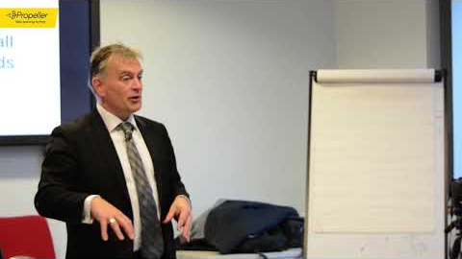
Suggestion 5 – Section by Section
Notes:
Use on section of the board to develop a mastery style approach. Here is the maths consultant, Anthony Reddy from Sense of Number showing how using just one section can develop understanding of number.

Slide 10
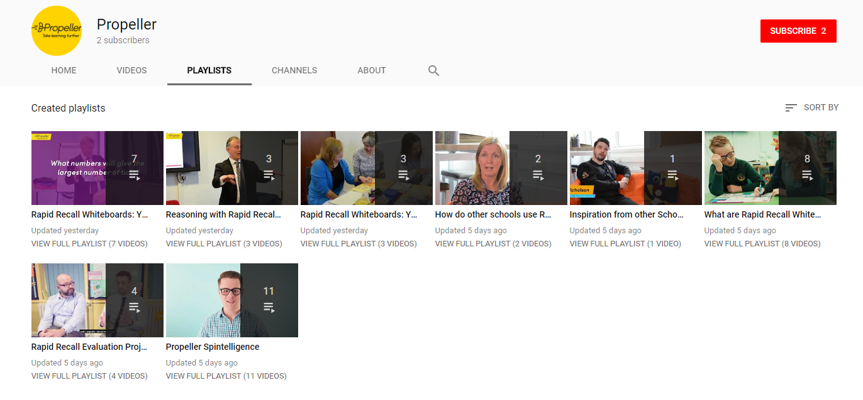
Teaching Videos – YouTube Channel
Visit our YouTube channel for a selection of exemplar videos.

Slide 11
Working with an adult in your year group/class, spend 10 minutes doing the following:
Visit www.propeller.education
Go to the Rapid Recall Whiteboards Section
Take time to explore the following 2 sections: ‘What are Rapid Recall Whiteboards?’ and ‘Take Rapid Recall Whiteboards Further’
At the end of the session, I will ask everyone to share:
How will you use your Rapid Recall in the first session?
What interesting information/downloads did you encounter on the website?
Notes:
Allow staff to do the above.
For maximum impact, we suggest telling staff that in 1 month’s time you will revisit Rapid Recall boards in the staff meeting. At this meeting you will ask staff to share
-How they have used it to inform assessment
-Most successful way of using it in their class

Slide 12
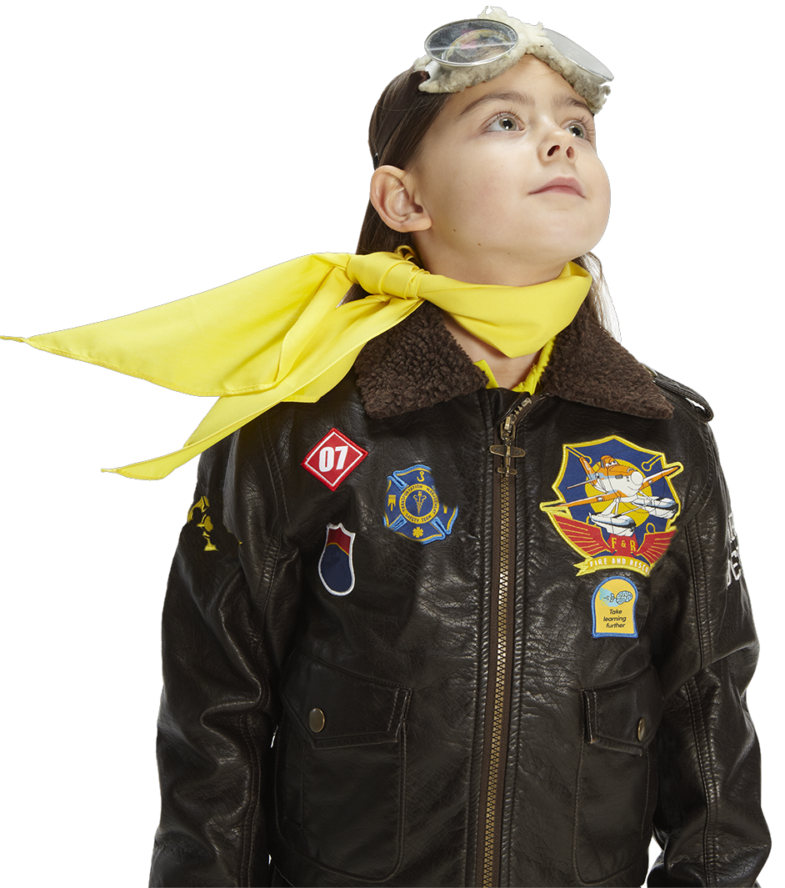
End of presentation
If you have any questions or queries please do not hesitate to contact us:
info@propeller.education
Tel: 01502 525588

